Slide 1
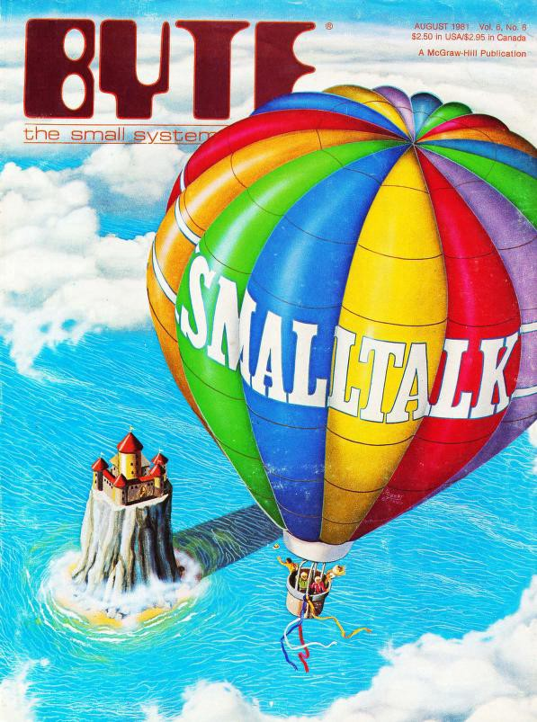
jk
By: Yannick Vaillancourt –
300226628

Slide 2
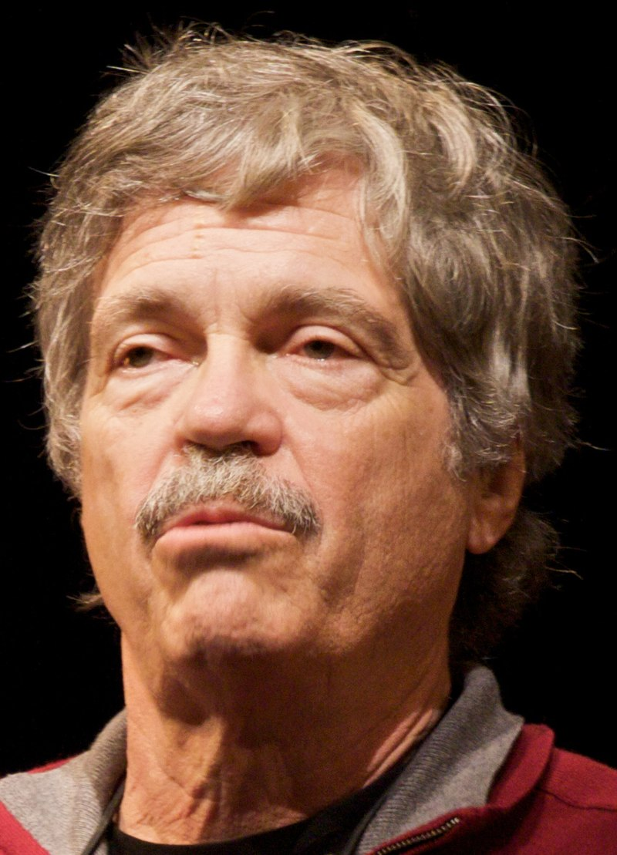
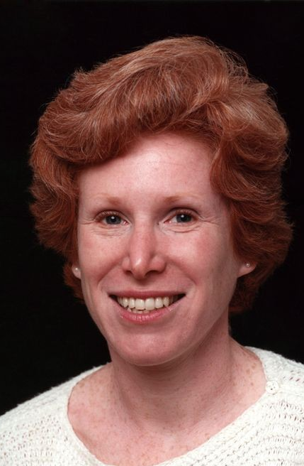
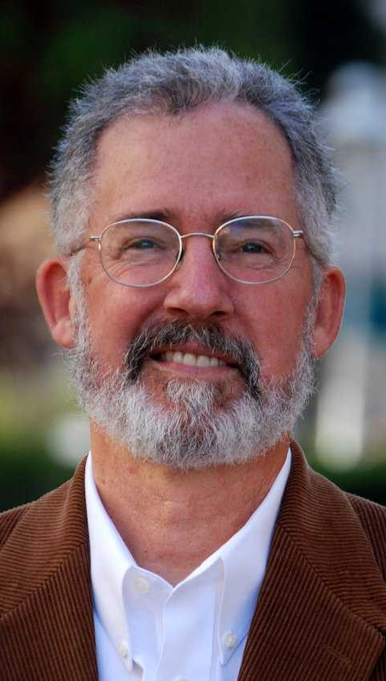
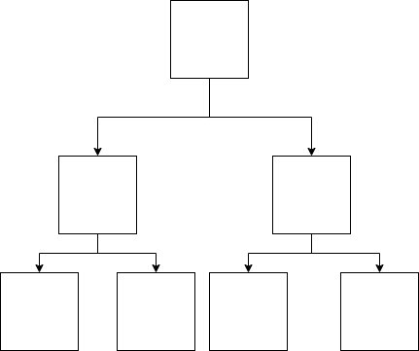
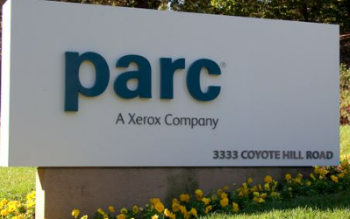
Small(talk) Beginnings
Goals of OOP
- Simplify handling complex systems
Allow hiding details (i.e. encapsulation)
Goals of Smalltalk
Pure OOP (OOP whether you like it or not)
Consistent representation
Low learning curve
Recursive Design
Divide computers into small computers
Dan Ingalls
Adele Goldberg
Alan C. Kay
Original designer of Smalltalk

Slide 3
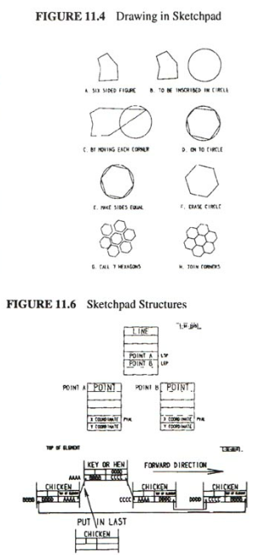
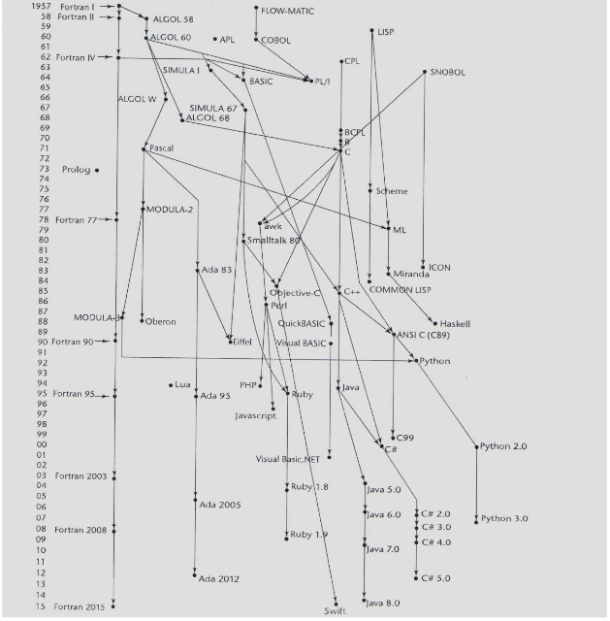
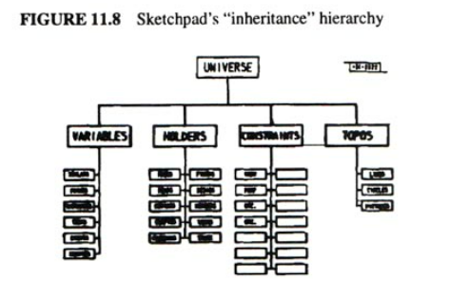
Smalltalk inspirations
Sketchpad & Simula
Sketchpad
First graphical computing tool Alan encountered.
‘Master drawings’ that produce and manage ‘instance drawings’.
Simula
Procedural programming language that brought in many OOP building blocks, which shared similarities to Sketchpad objects.

Slide 4
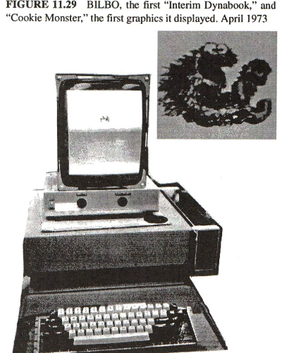
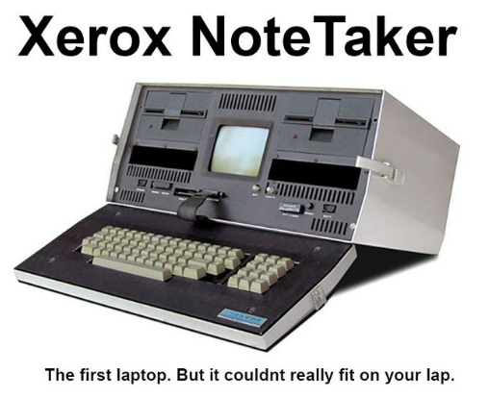
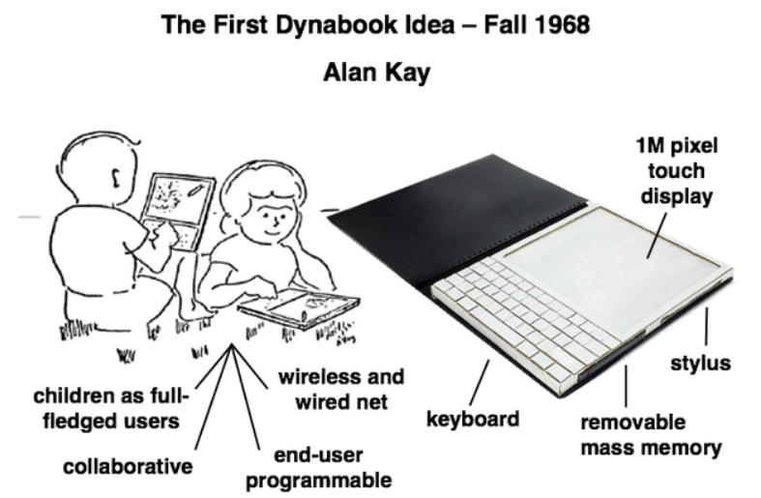
Early usage in Hardware
Dynabook
The first personal, portable computer prototype
Intended especially for use in education

Slide 5
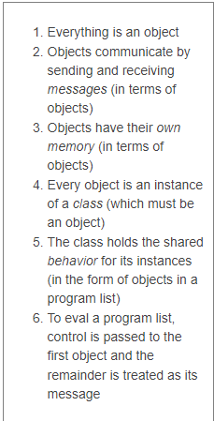
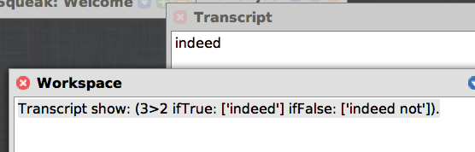
The Smalltalk language (X is an object example)
Object
Message

Slide 6
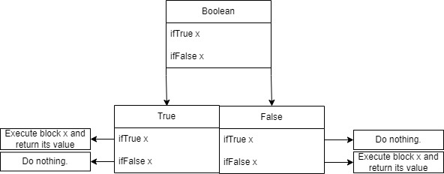
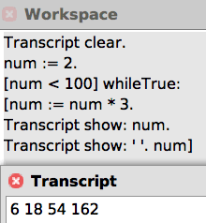
The Smalltalk language
Returns ‘True’ object
Polymorphism!

Slide 7
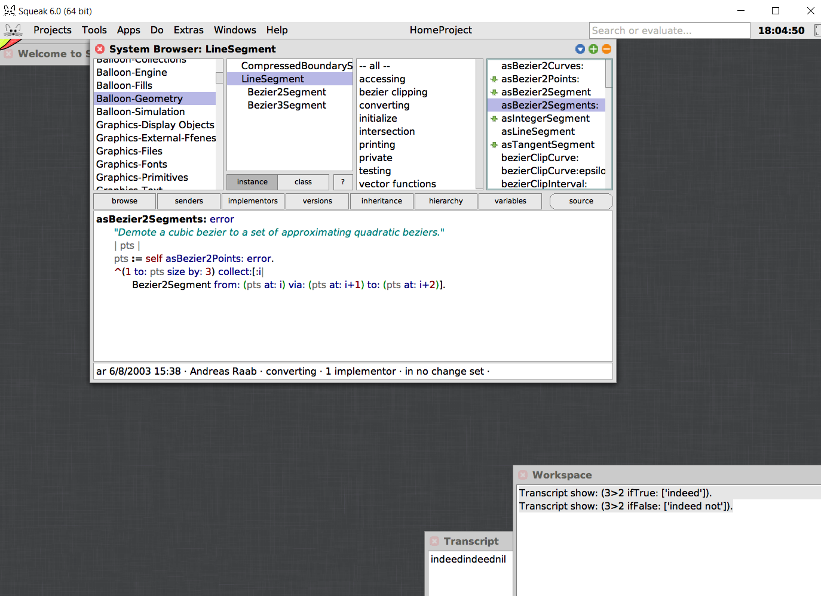
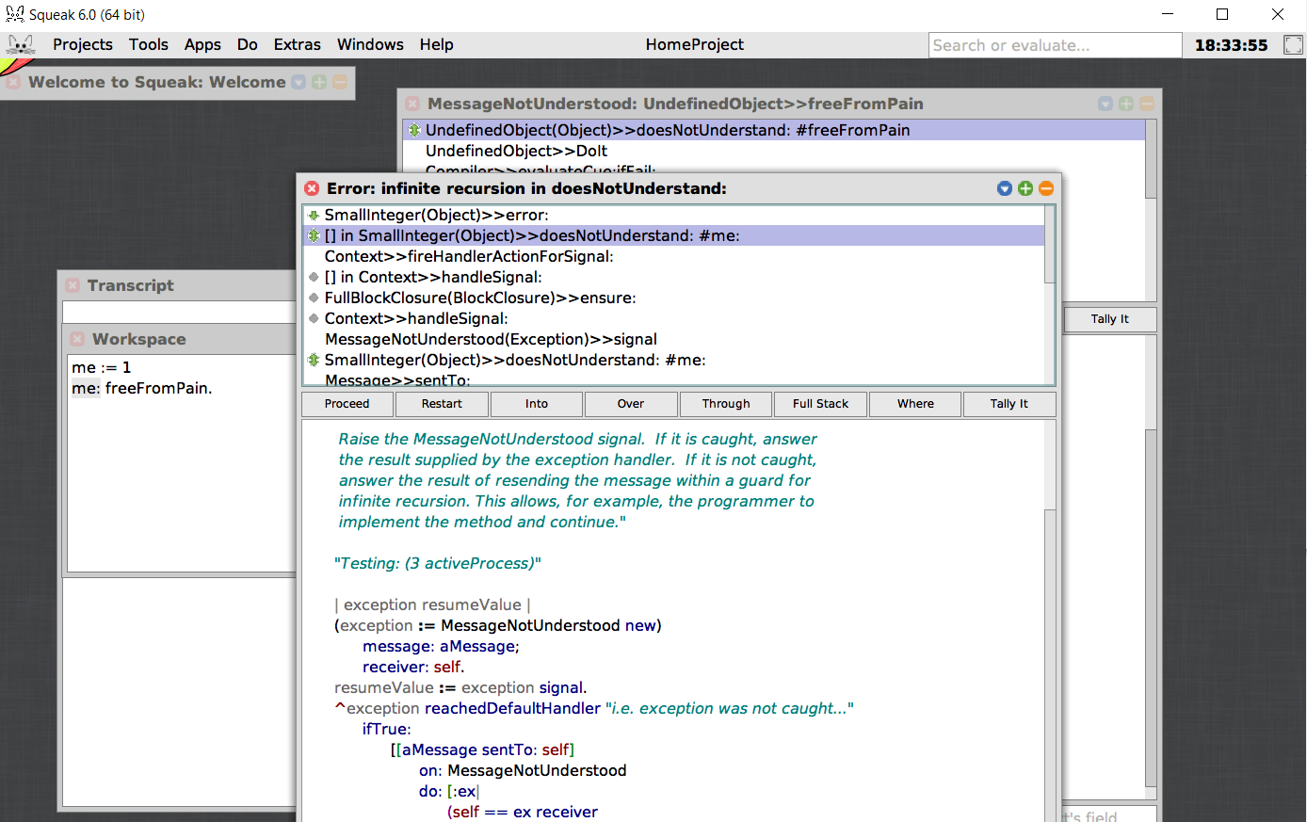
Other neat developments through Smalltalk
First fully formed Integrated Development Environment (IDE)
Including a debugger
Pioneered Model-View Controller for GUI design
Contributed to the rise of Test-driven development with SUnit

Slide 8
References
https://worrydream.com/EarlyHistoryOfSmalltalk/
https://learnxinyminutes.com/docs/smalltalk/
https://www.cincomsmalltalk.com/main/about-us/the-big-influence-of-smalltalk/
https://en.wikipedia.org/wiki/Extreme_programming

